Slide 1
ChoreTracker.com
Chris Lipscomb
Michael Morrison
Carolyn Zhang

Slide 2
Description
Choretracker.com is a website in which you can create groups or households that helps you track chores.
Users can report when someone does something that is detrimental (i.e. leaving dirty dishes in sink) to the cleanliness of the house/apartment or when someone does something to improve the cleanliness of the place (i.e. vacuuming/sweeping).

Slide 3
Audience
The audience or users of this website are roommates or household sharing members. It is aimed for people who share a household to track and reward or reprimand residences for maintaining the living area.

Slide 4
Areas of Focus
HTML/CSS – design and layout of the website
MySQL Database PULL/PUSH – Read and write information regarding roommates chores as well as keeping track of session information.

Slide 5

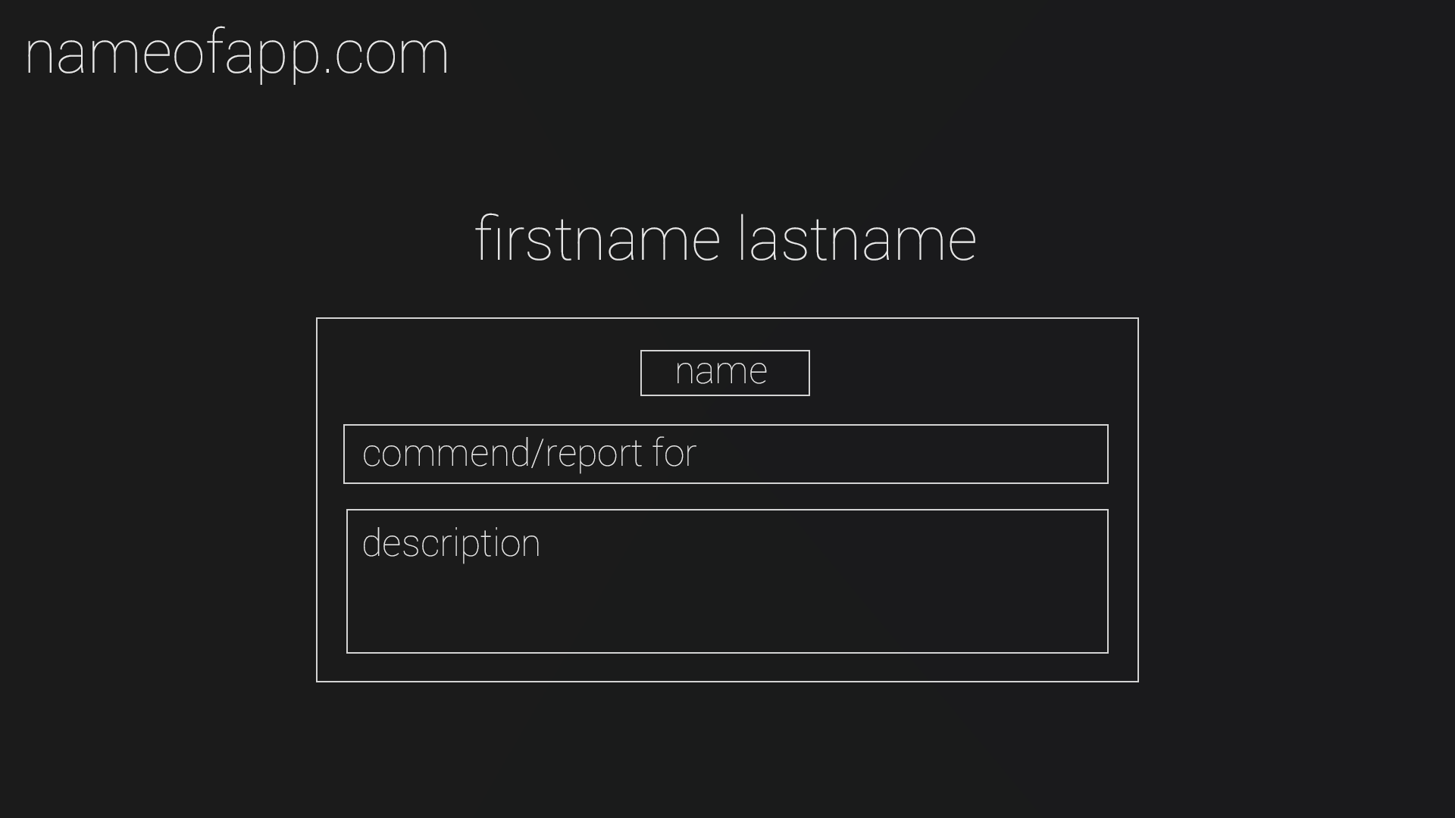
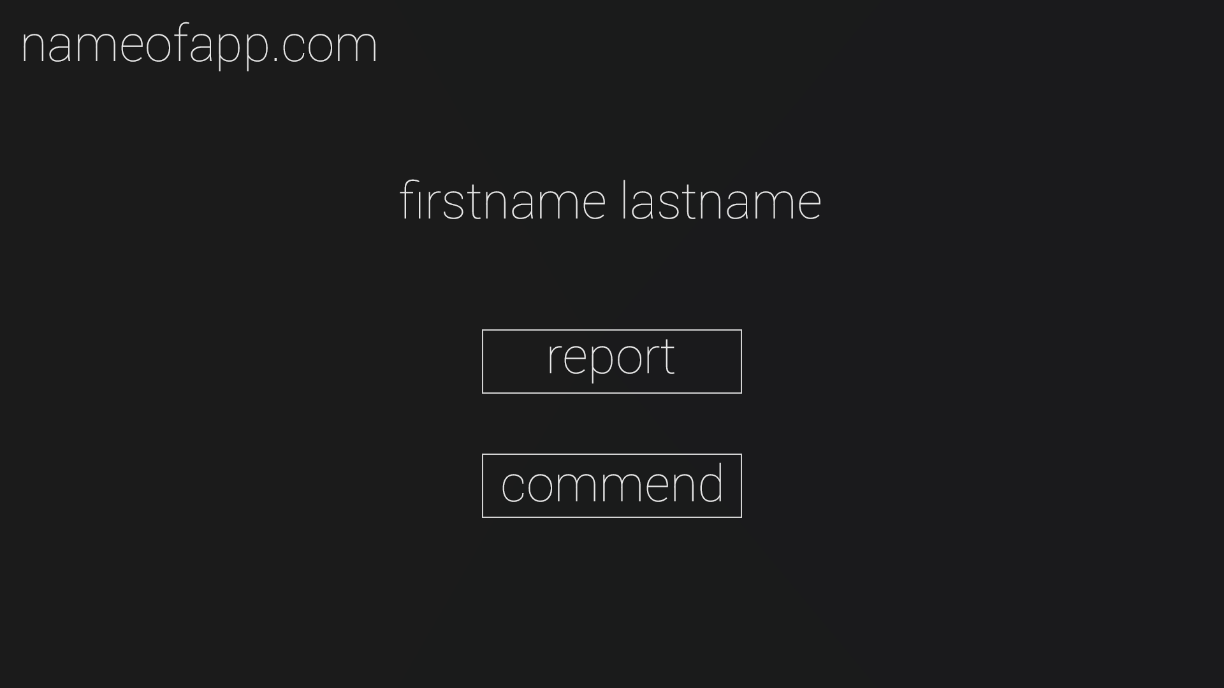
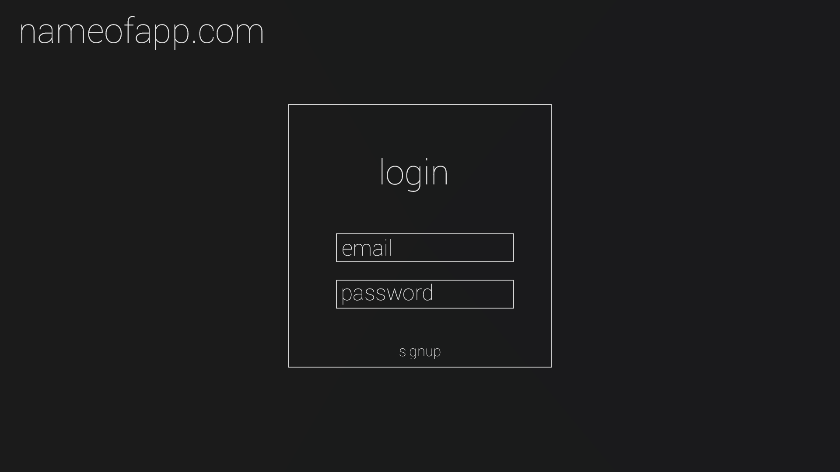
Initial Design ideas

Slide 6
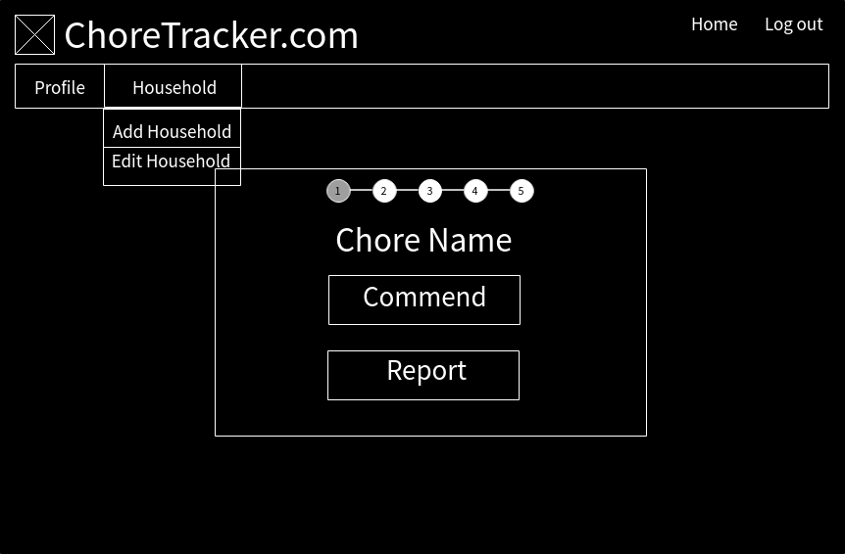
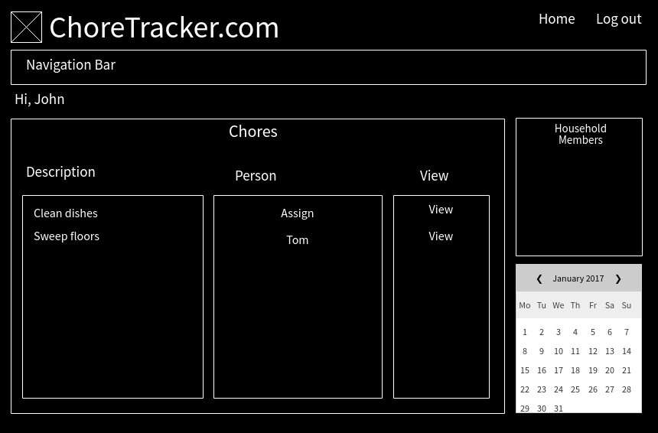
More Functionality

Slide 7
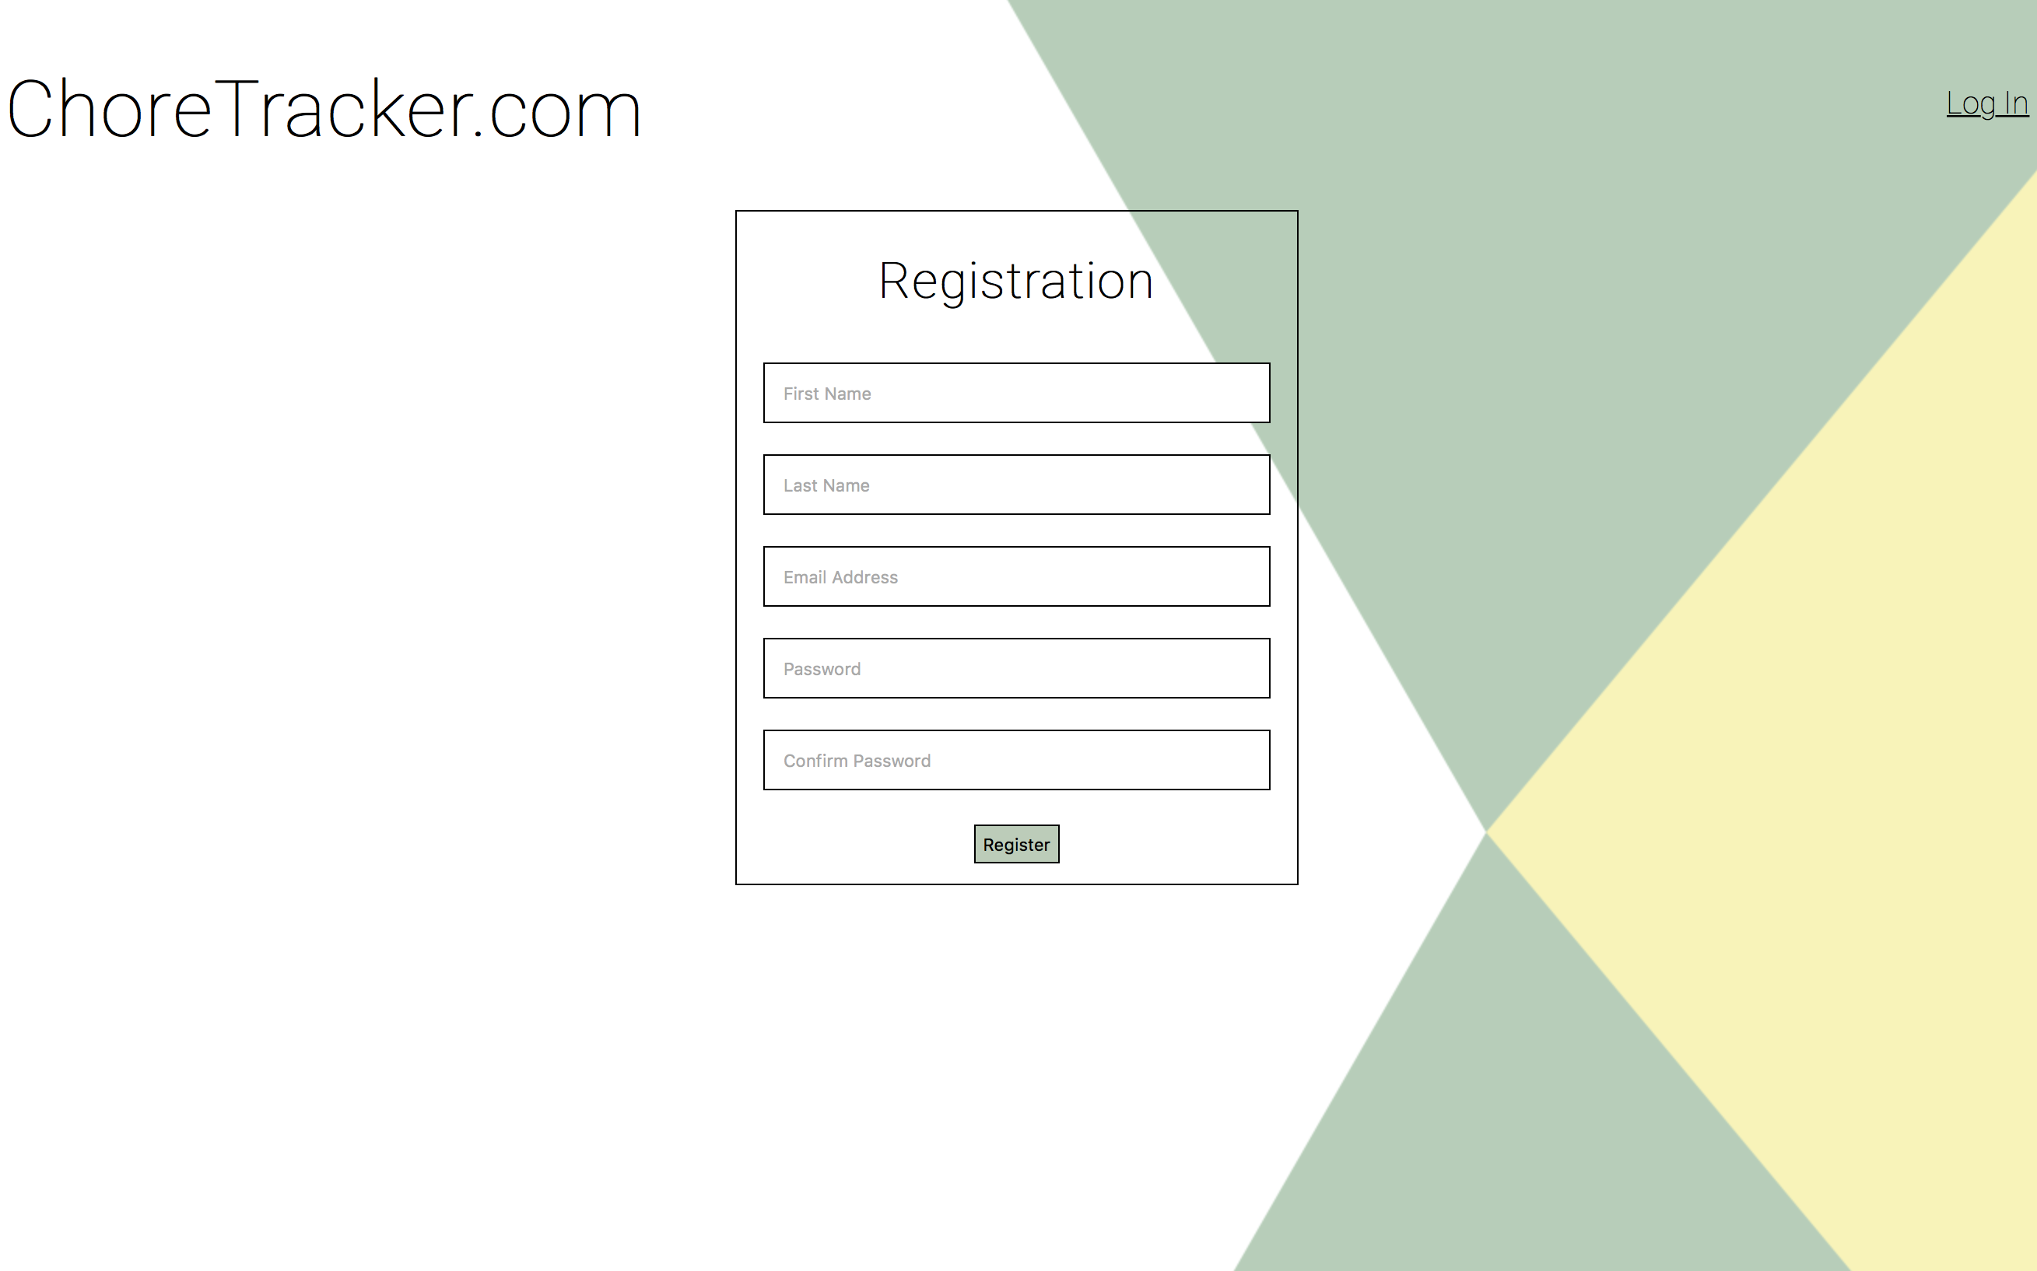
Later Design

Slide 8
Demo
http://localhost:8080/IIT-Project/index.php

